Slide 1
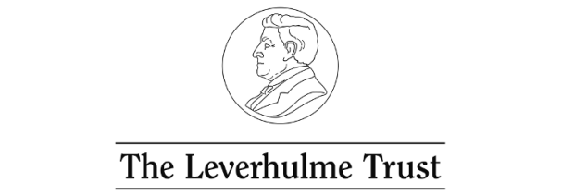







Youth activism, engagement and the development of new civic learning spaces
(Leverhulme International Network)
Thursday 13 June 2019
Houses of Parliament, London, UK

Slide 2
Project team
Ian Davies, University of York, UK.
Mark Evans, University of Toronto, Canada.
Márta Fülöp, Institute of Cognitive Neuroscience and Psychology, Hungarian Academy of Sciences and Eötvös Loránd University, Hungary.
Dina Kiwan, University of Birmingham, UK.
Andrew Peterson, University of South Australia and University of Birmingham, UK.
Jasmine Sim, National Institute of Education, Singapore.
Network facilitator: Wendy Burns, University of York, UK

Slide 3











Professor James Arthur
Dr Wei Shin Leong
Professor Antal Orkeny
Dr Alan Sears
Dr Maha Shuayb
Dr James Sloam
Professor Lynn Staeheli
Dr Libby Tudball
Budapest conference June 2019:
Panel members and key note speakers from:
Canada, Chile, Hungary, Lebanon,
New Zealand, Singapore, South Africa.

Slide 4
What did we do?
Literature reviews
Networking and public meeting in York, Toronto, Adelaide, Sydney, London, Birmingham
Conferences organised: Canterbury (2018); Budapest (2019)
Invited conference papers: BAICE (York), NECE (Marseilles), CIES (San Francisco), CiCea (Bruges and Prague)
Many publications (academic and professional): (https://www.york.ac.uk/education/research/cresj/researchthemes/citizenship-education/leverhulmeyouthactivism/)

Slide 5

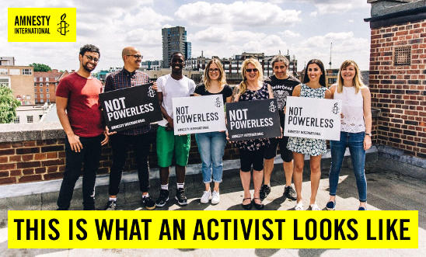

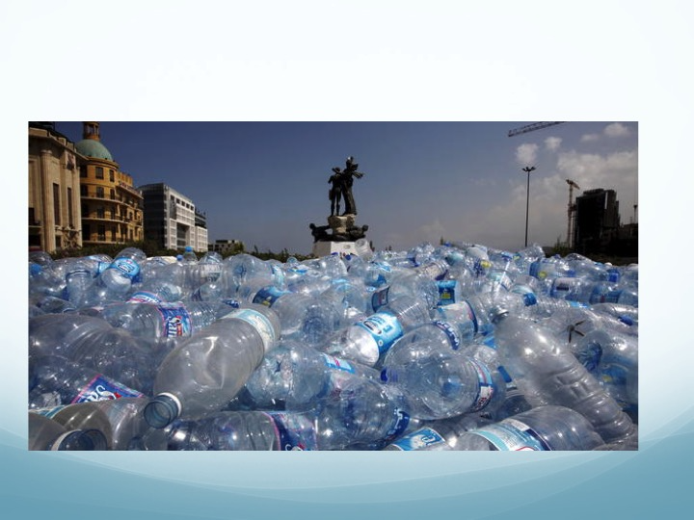
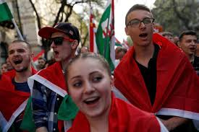
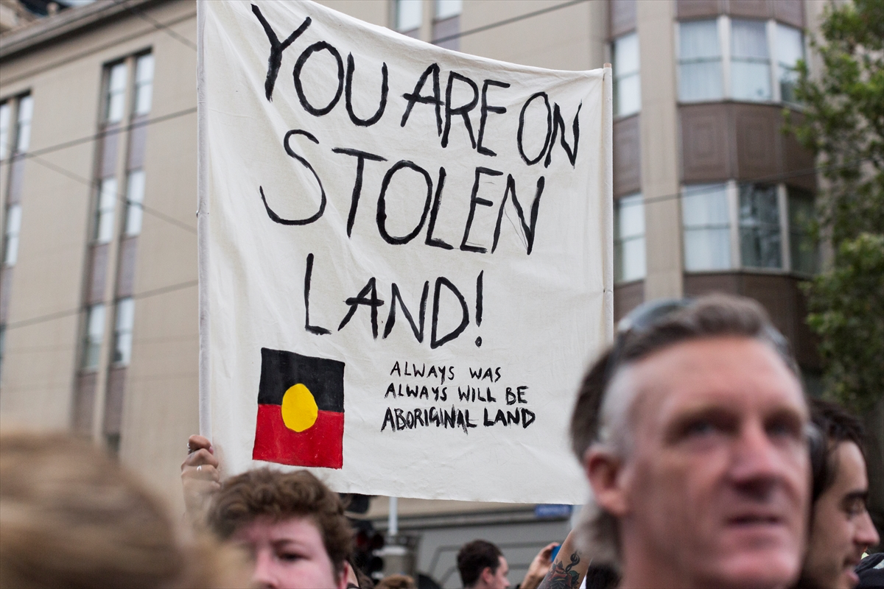
Youth activism, engagement and the development of new civic learning spaces:
A comparative perspective across six countries

Slide 6
Education and engagement: a virtuous circle?
Well qualified people are more likely than others to understand and play a constructive role in democratic societies. This engagement is perhaps the central purpose of schooling.
Outside school people will continue to learn. Through their engagement they will understand more about key issues and be better able to make things happen.

Slide 7
Education and engagement: a vicious circle?
If schools and individual teachers insist that students should become involved in particular causes for specific purposes, when do we need to draw the line? When would we suggest that indoctrination is being attempted?
And what happens when those young people become actively involved in the ‘real’ world beyond school? Is it possible that education is the last thing on the minds of most activists?

Slide 8
Research questions
How do young people, their educators and policy makers understand and construct their civic activism, including different forms, spaces, expectations, aims, and learning and teaching processes?
What are the mobilizing factors and inhibitors of such engagement?
What are the educational benefits and drawbacks of young people’s civic activism principally regarding identity, capacity and efficacy for individual and social benefit from the local to the global?
What educational processes are apt for optimising the educational benefits of young people’s civic activism?

Slide 9
Countries, characterizations and key terms
None of our countries represent a type but are important as individual sites and as means to reflect more generally.
Key terms: youth, education, engagement and activism
Styles of engagement: ‘political consumerism’ (Micheletti, 2003), ‘mundane citizenship’ (Bakardjieva, 2012), ‘self-actualizing citizen’ (Bennett , Wells and Freelon, 2011), ‘networking citizen’ (Loader, Vromen and Xenos, 2014), ‘critical citizen’ (Norris, 1999), ‘everyday-maker’ (Bang & Sorensen, 1999), ‘reflexive citizen’ (Bang, 2009) and ‘engaged citizen’ (Dalton, 2006 and 2008). (Behzad Fallahzadeh and Erik Amnå (2016)

Slide 10
Typologies
McLaughlin (1992): minimal-maximal continuum (values of identity, virtues, political involvement and social prerequisites).
Andreotti (2006): ‘soft’ and ‘critical’ approaches, particularly relevant to postcolonial, global and cosmopolitan perspectives on the choice between charitable, individually framed conservative approaches and the collective and structurally positioned inclusive and democratic stances.
Kahne and Westheimer (2004) the personally responsible; participatory; and, justice-oriented citizen.
Oxley and Morris (2013): cosmopolitan based (political, moral, economic and cultural) and advocacy based (social, critical, environmental and spiritual).

Slide 11
Australia
Strong policy rhetoric in support of youth social and political action
Concerns about levels of youth political knowledge and engagement
General interest in changing notions and practices of youth social and political action, including a focus on everyday and online levels of engagement
General recognition of persistent barriers: socio-economic, opportunities (or lack of), rurality, etc.
General appreciation of effective practice: supportive leadership, intentional planning of opportunities, working with young people etc.

Slide 12
Canada
• expressions of youth civic engagement in Canada have tended to be moderate, varied, local, and institutional; tempered historically by its evolving political culture, emergent internal and external circumstances and issues, and a filter of ‘nation building’ and personal and social responsibility
• studies undertaken since the 1990s report important shifts in how young Canadians are engaging in civic matters; suggesting less engagement in formal politics and an increasing level of involvement in what is referred to as ‘informal’ or ‘non-electoral’ political activities
• while involvement remains largely face-to-face, there is evidence of increasing online engagement with a broader range of civic issues in areas of personal interest (e.g., environment, Indigenous peoples’ concerns, access to higher education)
• youth civic engagement learning in Canada is supported by formal provincial and territorial education systems and a substantive civil society infrastructure (e.g., groups, organizations, NGOs) working in the interest of the citizens but operating outside of the governmental and for-profit sectors

Slide 13
Canada
• educating for civic engagement through formal education in Canada has undergone a gradual transition (at least in policy rhetoric) from an emphasis on civic duty and formal political structures and processes as they are to broadened characterizations that encourage more informal, exploratory, and critical understandings and practices of engagement
• interwoven into these understandings of engagement are themes such as identity, cultural diversity, pluralism, and issues of social justice and equity; indicators of these are found in spheres of Canadian educational research, curriculum policy reform, and pedagogical practices
• moving towards these broadened characterizations of civic engagement through formal education, however, have proven to be complicated; curriculum ambiguity, an avoidance of controversial concepts and issues, varied understandings of engagement among students with differing identity affiliations, for example, all signal uneven and fragmented access and learning experiences; further exacerbated by a variety of factors associated with educational change

Slide 14
England
Citizenship education: social and moral responsibility, political literacy and community involvement
In schools. Until 2013 - Key concepts (rights and responsibilities; democracy and justice; identity and diversity). Key processes (critical thinking and enquiry; advocacy and representation; participation and taking informed and responsible action). Since 2014 – civics; volunteering; critical thinking including personal finance. Generally, declining focus on education about and for engagement; greater emphasis on ‘traditional’ subjects; greater autonomy for individual schools (most now do not have to follow the National Curriculum); and more emphasis on character education.
Key factors in schools: conceptual framework (not primarily issues or content); discrete provision; assessment; pedagogical engagement; status/support)
Issues beyond schools: social media, Europe, National Citizen Service, votes at 16, the environment, Britishness and diversity.
Key factors beyond schools: social capital; issue commitment; efficacy; practical support

Slide 15
Hungary
Socialism 1945-1989; post 1989 capitalist democracy
The parents of Hungarian youth are the ‘alpha-omega’ generation (i.e., the last children of the old socialist system and the first adults of the new capitalist democracy)
15 to 29 years-old are the ‘Beta generation’ who were born into a democratic political system and a capitalist market economy
Youth have a low level of political interest, non-involvement in organisations, right-wing political preference, strong commitment to democracy (half of them are satisfied with the current level of democracy, half of them not), more liberal than conservative values, strong pro-European attitudes.
Online activism is growing and off-line activism is organized via online activity.
Youth activism takes place in relation to policies that have a direct impact on young people’s lives (internet tax, tution fee, compulsory language exam etc.). It is not-related to wider political issues e.g. freedom of media, constitutional issues, control over scientific life etc.

Slide 16
Hungary
Following the political changes, citizenship education was not included as a separate school subject, primarily because of the fear of political indoctrination.
Civics related knowledge is included in social studies (especially history) but is neglected by teachers as they prioritize exam preparation for entry to higher education.
Thus, there is a generation of parents and young people who has not been educated about citizenship related issues and who are mostly not sensitive to politics.
Education for activism is non-existent in the school system.
Non-formal civic education (e.g.education for democracy) was very widespread after the political changes but the number of NGO’s devoted to political education has dramatically decreased.

Slide 17
Lebanon context
- With a history of armed conflicts and as a site of displaced populations, Lebanon is characterized by sectarian divides with further differences along axes of age, gender, sexuality, disability and national legal status.
- Huge wealth inequalities with Lebanon having third highest wealth inequality in the world (Blog Baladi, 2013).
- An estimated 1.5 million Syrian refugees, in addition to a pre-existing Palestinian refugee population (some now third generation) of 450,000 with curtailed civil, economic and political rights and no route to legal citizenship Lebanon has largest number of refuges relative to its national population in the world (UNHCR, 2016).
- Large youth population - median age of 28.5 in 2015 (Statistica.com). In 2016, 52% under age 29 (Populationpyramid.net). Syrian refugee population- 55% under the age of 18 (UNHCR, 2018).

Slide 18
Lebanon
Conceptions of Youth
-In Arab world and in Lebanon, ‘youth’ commonly constructed as the intermediate stage between childhood and marriage, when young people would leave home;
- ‘Arab Spring’;
- Varying conceptions: instrumental, vulnerable, morally deficient, apathetic/hedonistic
Conceptions of Activism
- multiple actors;
- what counts as activism, not necessarily progressive but can be illiberal;
- e.g ‘trash crisis’.

Slide 19
Singapore
Small nation-state (719.1 sq km, 5.5m/3.4m citizens), only 54 years as independent nation; lacked natural resources, no hinterland, sandwiched between 2 big countries
British colonial era 1819-1942; Japanese Occupation 1942-1945; British Crown Colony 1948-1963; Internal self-government 1955-1963; Merger with and Separation from Malaysia 1963-1965; Republic of Singapore 1965-present
Governed by the People’s Action Party since 1959, strong legitimacy, transformed Singapore into a thriving global city in 3 decades; ideology of survival - politics should be about good, sound policy, not personality or ideology
Limits to democracy are necessary for the country's survival and prosperity, citizens can give up certain sociopolitical freedoms in exchange for this
Singapore government is single-minded in the pursuit of citizenship education, taken many forms over the years for the purpose of nation-building; latest initiative is Character and Citizenship Education

Slide 20
Singapore
Schooling is the main source of formal citizenship education, co-ordinated and sustained effort is made to transmit a particular knowledge and values, develop the right instincts and attitudes s deemed necessary for the survival of Singapore
Citizenship centres on the nation, not the individual; emphasizes responsibilities and duties, loyalty and patriotism, submission of individual interests to the common good, contributions citizens can make to the country
Active citizenship emphasizes the practice of consensual politics among its citizens where civic virtue is defined as grassroots volunteerism in which people organize to help each other without having political ambition
Changing landscape and challenges: globalization, greater social class differences, emergence of new lifestyles, widespread use of social media, greater diversity in population result of immigration, super aged society, young value freedom and individual choice, want more control in personal spheres and more say in the collective decision-making

Slide 21
Overarching ideas and issues
In the project certain similar concepts emerged in each of the 6 contexts, though not always to the same extent
The real learning from the project has been the similarities in the concepts used, but the significant variations in their application and contextual meanings.
These are revealed through the expressions of youth engagement in each country and in the ways learning experiences occur
A significant element of the variations is due to the existence and operation of intersectionalities that are distinctive (though not necessarily unique) to each country.

Slide 22
Relational Capacities: a way of understanding
education and engagement?
We emphasize the interdependence of social context and relationality, two key characteristics in our proposed framework of relational capacities. We recognize that capacities across the six countries, and when applied elsewhere, would have to be understood as mutually constructing, complex and contextual (Hopkins, 2017).
Broadly, we argue for 2 types of relational capacities:
1. Societal – capacities which are about how youth understand and relate to their communities (largely vertical – citizen to state)
Understanding of context
Making meaning of citizenship
2. Interpersonal – capacities which are about how youth understand and relate to other people (largely horizontal – citizen to citizen)
Working with others
Reflexivity

Slide 23
Pedagogically, at least rhetorically,
there is an increasing emphasis on:
Real life and relevant political questions
Varied ways of knowing and active involvement in the learning process
Enquiry-based learning
Decision-making, public issue investigation, ethical thinking, peace-building and conflict management
Collaboration and deliberative discussion
Varied learning approaches and practices that are equitable and responsive to learner diversity
Safety and well-being, and self-reflection

Slide 24
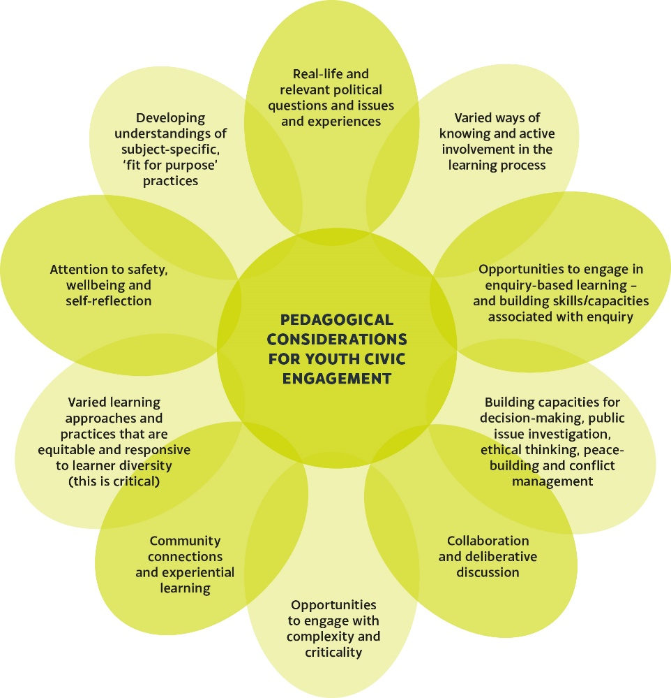
Pedagogical considerations:
A review of studies explicitly associated with ‘educating for civic engagement’ throughout the 20th and into the 21st centuries reveals deepening and shifting understandings and intentions of pedagogical approaches and practices (in theory and practice)

Slide 25
Questions about civic learning:
• Is there a continuing culture of ‘transmission’ oriented teaching and learning related to civic engagement learning?
• Are there fragmented theoretical policy constructs?
• Are there limits to critique and a privileging of particular learning goals?
• How responsive are students’ learning experiences of civic learning to their identity affiliations and socio/economic circumstances?
• How do different contexts and forms of democracy shape distinctive curricular and pedagogical preferences for particular kinds of citizenship and democratic practice?
• Are educators suitably prepared to effectively address the complexities of teaching and learning for democratic engagement?

Slide 26
Recommendations
Clarify the characterization of education about, through and for civic and citizenship engagement. This is a call for a form of knowledge that is robust and dynamic.
Enhance the status of the area (e.g., research-based, professional associations etc.)
Ensure an appropriate pedagogical strategy that is capable of crossing boundaries (e.g., school-community) and making connections (e.g., teaching and assessing).

